Slide 1


Enhance Your Security Posture with the Power of Threat Modelling
Danielle Dias
Senior Backend Engineer
OWASP Bristol Chapter
November 2025
Notes:
Intro:
Me, what I do, previous experience, interest in security

Slide 2




Security
Protection
Reputation
Notes:
In today’s ever-evolving landscape of cybersecurity, securing endpoints remains a critical challenge. Despite current strategies and practices, attackers continue to find new ways to exploit vulnerabilities.
This highlights the need for a proactive "shift-left" strategy to detect and address threats early in development.
Companies face vulnerable to attacks when they lack awareness and understanding of security testing tools like Burp Suite, a comprehensive web application testing tool, especially in the early stages.
House.

Slide 3
Threat Modelling: What and why?
How do you actually Threat Model?
Threat Modelling in Action
Enhance Your Security Posture
Notes:
"Here’s what we’ll be covering today: we’ll start by defining what Threat Modeling is and why it's a critical part of your development process. Then, we’ll discuss how to actually implement it in your projects. Finally, we’ll look at a real-world example and see how threat modeling can enhance your security posture."

Slide 4
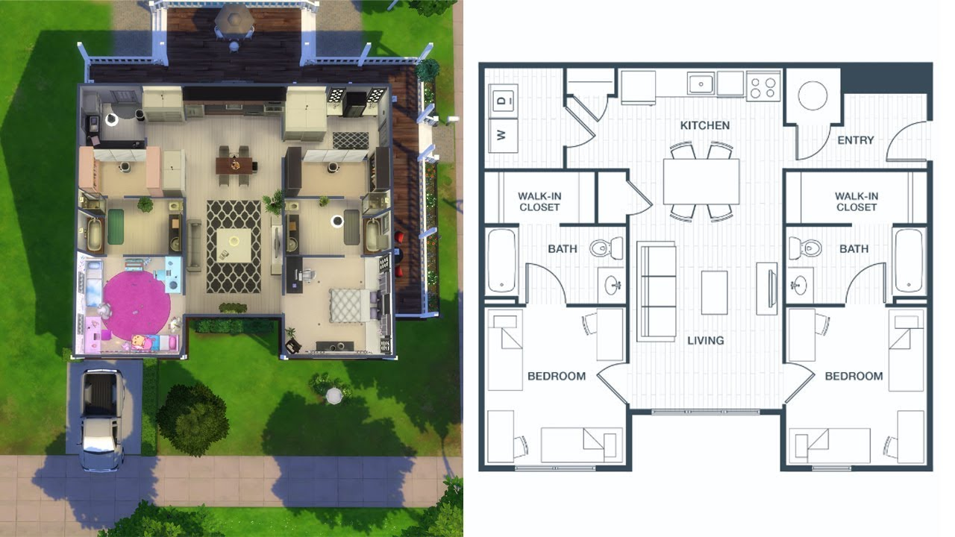
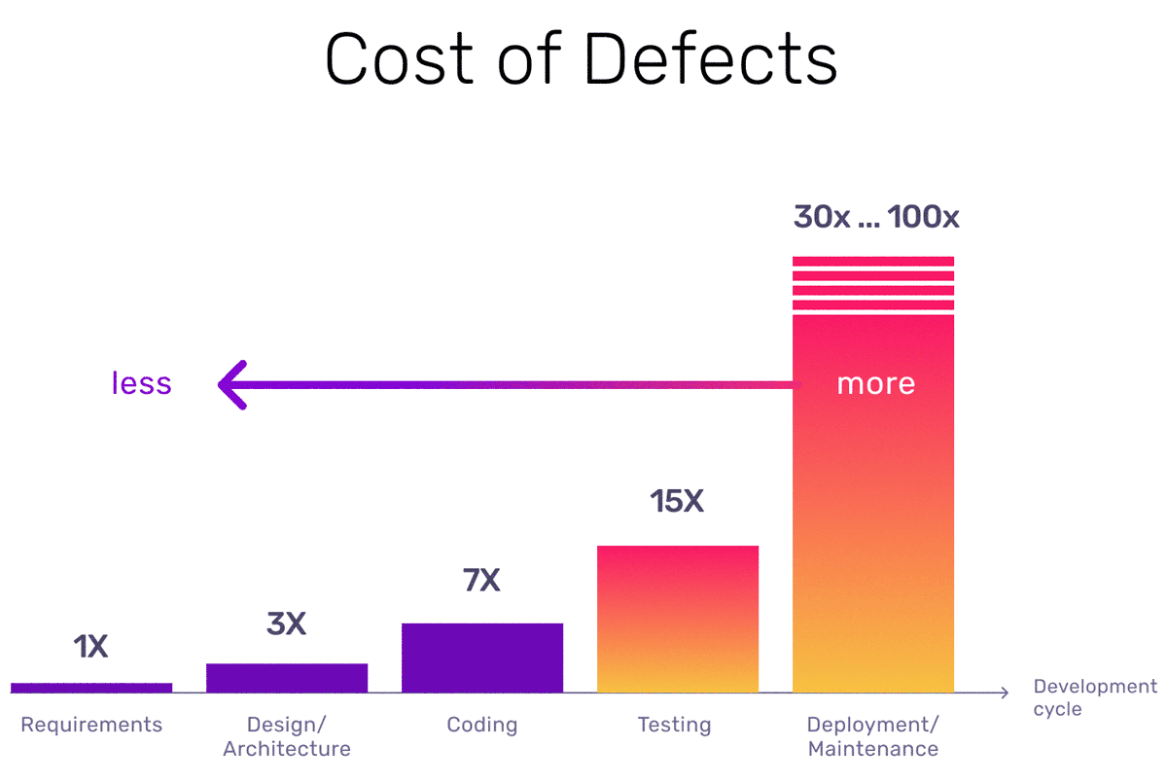
"If you fail to plan, you are planning to fail."
Notes:
The Ensuite Analogy — Planning vs Retrofitting
"If you’re building a house, when’s the best time to plan for an ensuite bathroom? At the design stage — before you’ve built the walls, run the plumbing, and painted everything."
"Trying to add an ensuite after the house is finished means ripping up floors, breaking walls, and spending way more time and money than if you’d planned for it up front."
Relating it back to Cyber Security:
"It’s exactly the same with security. Threat Modelling lets you ‘design in’ security controls early — before the code is written or systems are built. If you leave it too late, fixing security issues becomes messy, disruptive, and expensive."
https://dzone.com/articles/quality-is-the-answer

Slide 5
What are we building this sprint?
As a business customer,
I want to download a VAT receipt for my purchases,
So that I can claim back VAT and keep accurate financial records for accounting purposes.

Slide 6

Integrating Threat Modelling:
Designing for Security
The Overlooked Aspect
Notes:
Product Focus:
Applications are designed to meet functional and business requirements
The Overlooked Aspect:
Ensuring the software works only as intended - preventing unintended behavior that could be exploited by attackers

Slide 7
Introducing Threat Modelling
“Threat modelling works to identify, communicate, and understand threats and mitigations within the context of protecting something of value.”
The Open Worldwide Application Security Project (OWSAP) - Threat Modelling

Slide 8
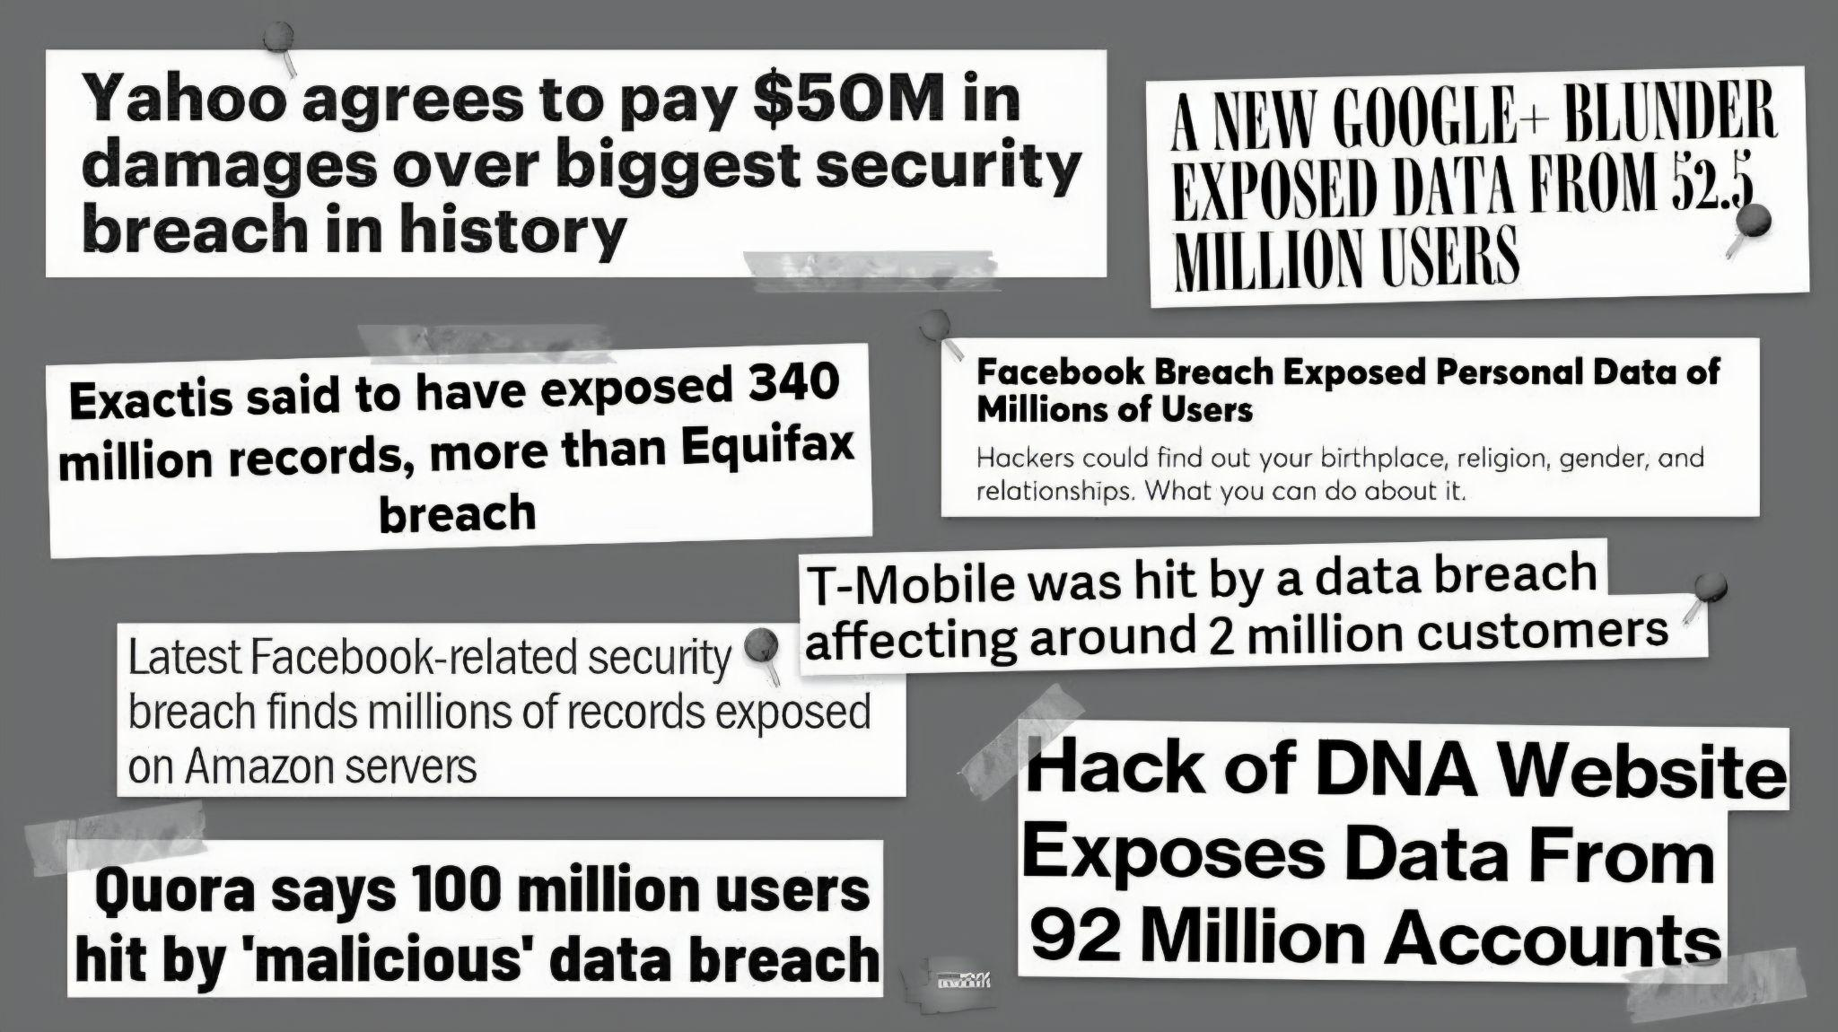
What’s at Stake?
Notes:
"So, why should we care about Threat Modeling? The risks of not integrating security early can have significant consequences for businesses. Let's look at some of the key stakes here:
Financial Loss: A security breach can result in direct revenue loss, costly fines, and expensive legal fees.
Infrastructure Costs: Increased cloud usage and additional security measures to mitigate risks can escalate your operational costs.
Delays to Future Features: Security issues often push back development timelines, slowing down innovation and future feature releases.

Slide 9

What’s at Stake?
Financial Loss
Infrastructure Costs
Delays to Development
Operational Strain
Notes:
Financial Loss
Security breaches can result in lost revenue, fines and legal fees
Infrastructure Costs
Increased cloud usage and additional security measures can drive up operational costs
Delays to Development
Addressing security issues can slow down development and innovation
Operational Strain
Security incidents put strain on teams and disrupt productivity, drawing people from across the organisation into firefighting and crisis response

Slide 10

Putting Threat Modelling into Action:
The Four-Question Framework
Accessible & Effective
Early Threat Identification
Security by Design
Notes:
Accessible & Effective
Easy to implement, even for those without deep security expertise
Early Threat Identification
Spot threats early in the design and development process
Security by Design
Embeds security from the start, reducing risks later

Slide 11
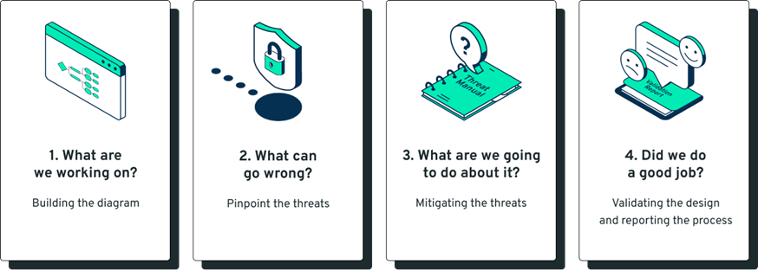

The Four-Question Framework for
Threat Modelling
iriusrisk: The Four-Question Framework for Threat Modelling
Notes:
"To identify risks before they become real threats, we start by asking four key questions: First, ‘What are we working on?’ This involves identifying the assets we need to protect and clearly defining security objectives. We also need to understand how data moves within the system to spot any weak points."

Slide 12

What are we working on?
Whiteboarding
Data Flow Diagrams
Involves Multiple People
Notes:
Whiteboarding
Use this to brainstorm and sketch out key system components and potential entry points
Data Flow Diagrams
Diagram the flow of data through the system to identify potential vulnerabilities
Involves Multiple People
Security is a shared responsibility, with each team contributing to identifying and
addressing risks

Slide 13

What can go wrong?
Think Like an Attacker
Collaborate
Use Structured Approaches
Notes:
Think Like an Attacker
Anticipate how an attacker might exploit vulnerabilities to gain unauthorised access or
cause damage
Collaborate
Collaborate with cross-functional teams to brainstorm possible threats and attack
vectors, ensuring diverse input
Use Structured Approaches
You can use structured approaches, like frameworks or checklists, to systematically identify and assess security threats

Slide 14

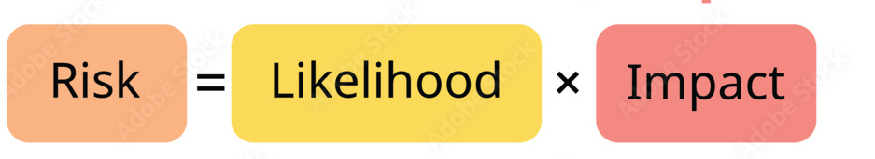
What are we going to do about it?
Evaluate and Prioritise Risks
Track and Manage Risks
Integrate Security into Development
Notes:
Evaluate and Prioritise Risks
Assess the likelihood and impact of threats, then prioritise mitigation efforts or decisions to accept or transfer risks
Track and Manage Risks
Continuously monitor the status of risks and integrate risk management practices
to ensure ongoing protection against evolving threats
Integrate Security into Development
Incorporate security measures into feature development to prevent vulnerabilities
from being introduced in the first place

Slide 15

Did we do a good job?
Evaluate the Security Approach
Security checklist
Continuous improvement
Notes:
Evaluate the Security Approach
Measure the effectiveness of your security strategy
Identify vulnerabilities and ensure they’ve been properly addressed
Security checklist
Use a comprehensive checklist to confirm that all security requirements and best
practices are met
Continuous improvement
Regularly review and enhance security measures to stay ahead of evolving
threats

Slide 16
When to Carry Out Threat Modelling
During Design
Before Major Architecture Changes
Security Reviews
After Incidents
Notes:
During Design
Identify risks early, before code is written
Before Major Architecture Changes
Cloud migration, third-party integrations, or new platforms
Security Reviews
Integrate threat modelling into secure development lifecycle
After Incidents
Learn from incidents to identify gaps and improve future designs

Slide 17
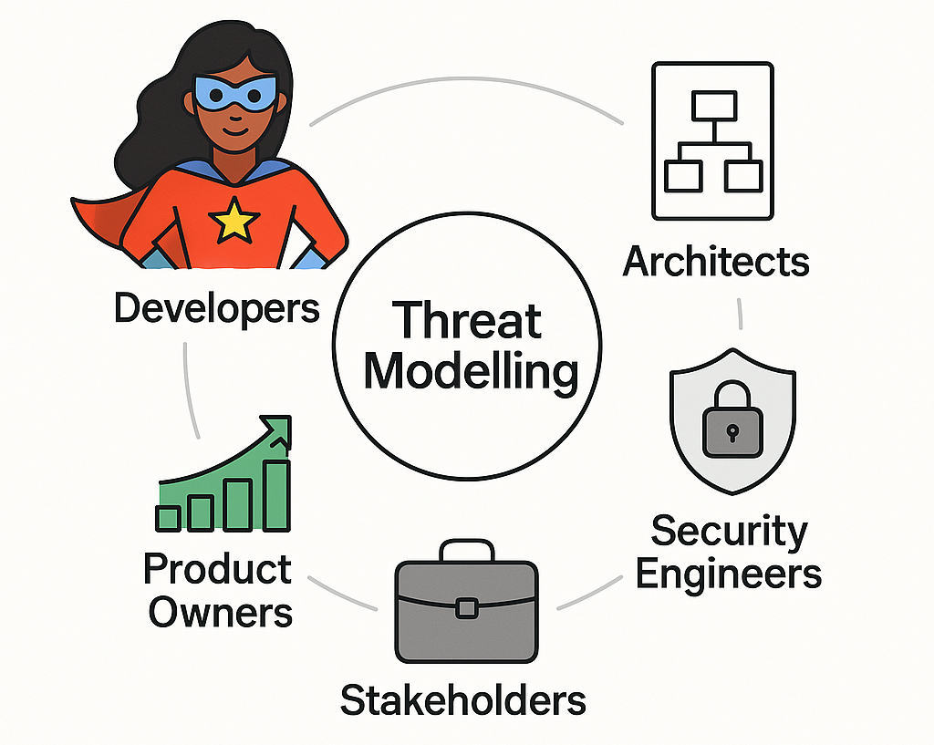
Who to Involve
Notes:
Cross-functional Collaboration is Key.
Who to Involve
Role
Contribution
Developers
Deep knowledge of system design & implementation details
Architects
Understand overall system structure & integration points
Security Engineers
Identify threats, vulnerabilities, and security controls
QA/Testers
Think from abuse & misuse cases perspective
Product Owners / Business Stakeholders
Bring business context, priorities, and risk appetite
Threat Modelling is most effective when technical and business teams work together.

Slide 18

Choosing the Right Approach
STRIDE
Categorise threats: Spoofing, Tampering, Repudiation, Information Disclosure, Denial of Service, Elevation of Privilege
PASTA
Risk-driven approach: Process for Attack Simulation and Threat Analysis
Attack Trees
Visualise attacker goals and paths
Security Checklists
Quick and repeatable prompts for identifying
common security issues
Notes:
The site map shows the information that Burp collects as you explore your target application. It builds a hierarchical representation of the content from a number of sources.

Slide 19
Free and Open-Source Tools
OWASP Threat Dragon
Open-source Threat Modelling platform with a user-friendly interface
IriusRisk Community Edition
Comprehensive Threat Modelling tool with risk assessment capabilities
app.diagrams.net / draw.io
Easy-to-use diagramming tool

Slide 20
What are we building this sprint?
As a business customer,
I want to download a VAT receipt for my purchases,
So that I can claim back VAT and keep accurate financial records for accounting purposes.

Slide 21
What are we working on?

Slide 22
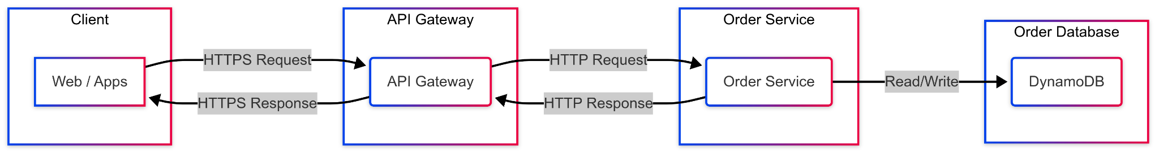
VAT Receipt Example
What are we working on?

Slide 23
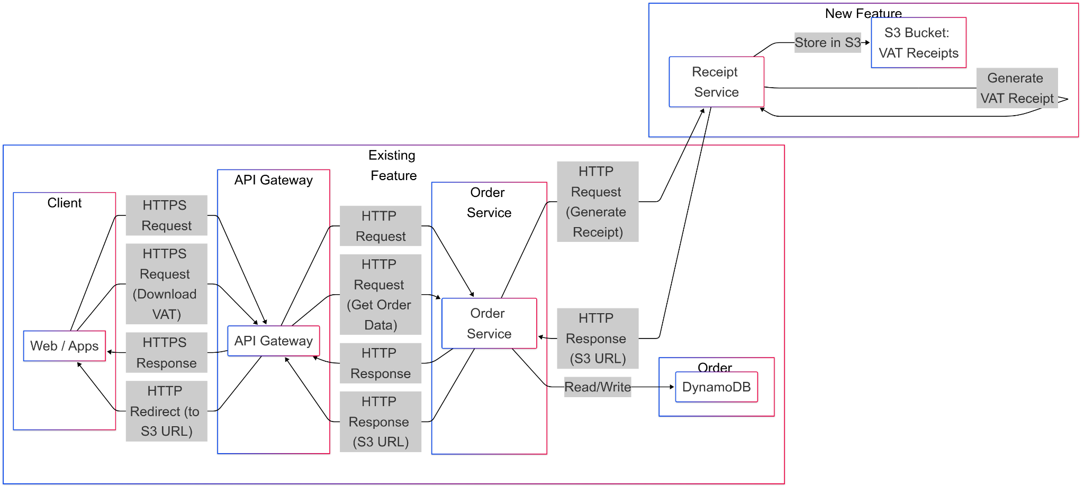
What are we working on?

Slide 24
What can go wrong?

Slide 25
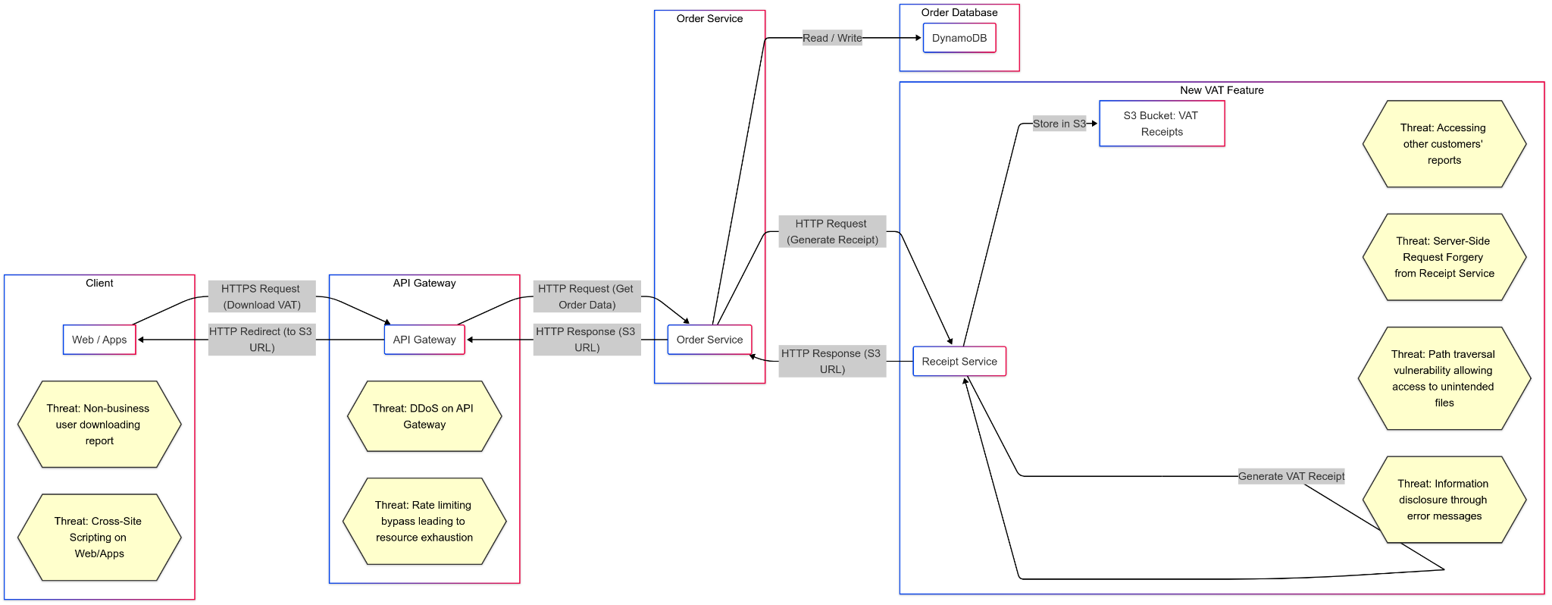
What can go wrong?

Slide 26
What are we going to do about it?

Slide 27
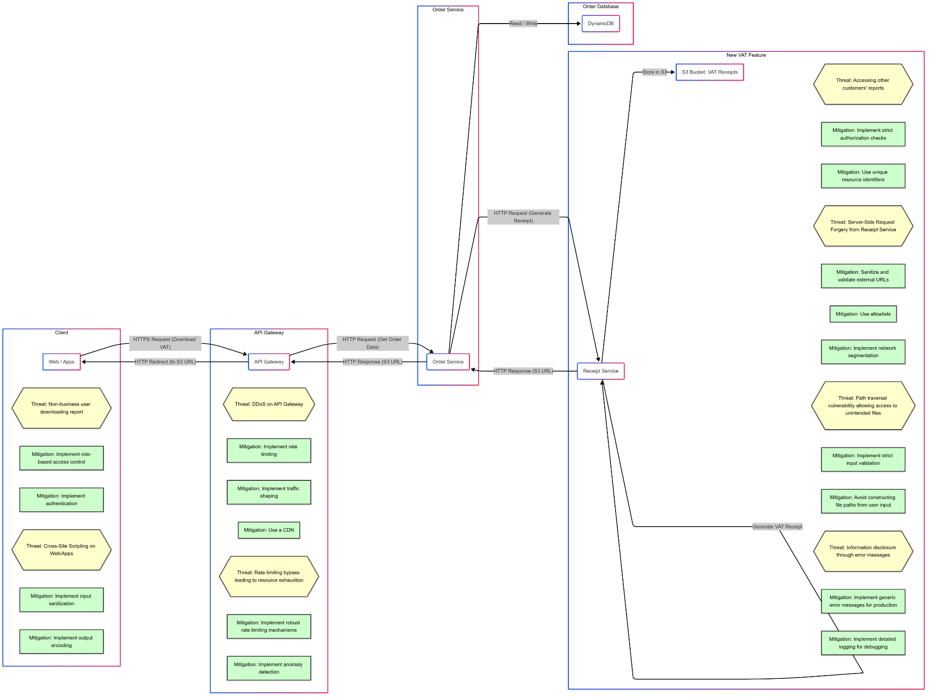
What are we going to do about it?

Slide 28
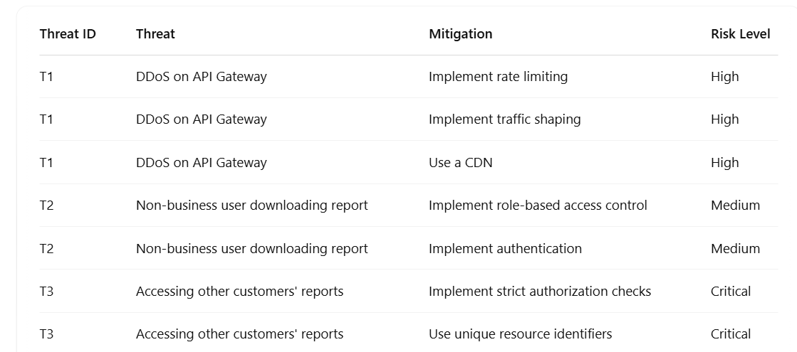
Threats, Mitigations, and Risk Levels

Slide 29
A Small Time Investment for Big Returns
Spot Hidden Flaw
Consider New Attack Vectors
Better Quality and Design
Define Security Requirements
Enhanced Understanding
Cost Savings
Notes:
Cost Savings
Address vulnerabilities in design or planning phases to avoid expensive fixes
post-release
Spot Hidden Flaw
Identify design weaknesses that tradition testing methods or code reviews might
overlook
Consider New Attack Vectors
Evaluate threats you may not have anticipated, improving overall resilience
In the ever-evolving landscape of cybersecurity, securing endpoints remains a critical challenge. Despite current strategies and practices, attackers continue to find new ways to exploit vulnerabilities.
This highlights the need for a proactive "shift-left" strategy to detect and address threats early in development.
Companies face vulnerable to attacks when they lack awareness and understanding of security testing tools like Burp Suite, a comprehensive web application testing tool, especially in the early stages.
House.

Slide 30
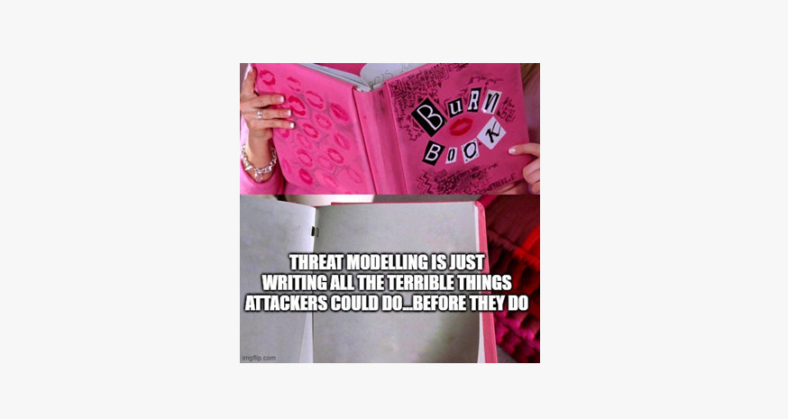

From Barriers to Breakthroughs
Challenge | Solution
Lack of security expertise | Training & foster cross-team collaboration
Time constraints | Start small, focus on critical assets, and iterate
Aligning technical & business risks | Involve both technical teams and business stakeholders early
"Only for security teams" mindset | Involve developers, architects, and business stakeholders
Resistance to change | Demonstrate ROI and tangible security benefits to gain buy-in
Notes:
In the ever-evolving landscape of cybersecurity, securing endpoints remains a critical challenge. Despite current strategies and practices, attackers continue to find new ways to exploit vulnerabilities.
This highlights the need for a proactive "shift-left" strategy to detect and address threats early in development.
Companies face vulnerable to attacks when they lack awareness and understanding of security testing tools like Burp Suite, a comprehensive web application testing tool, especially in the early stages.
House.

Slide 31

Security
Protection
Reputation
Notes:
Proactive Security Testing
Act before attackers exploit flaws:
Integrate security assessments early in the development lifecycle to identify and address vulnerabilities proactively. Don’t wait for penetration testers, and bug bounty programs
Prioritise security testing:
Make security an essential step of every stage, preventing it from becoming an afterthought and reducing the risk of exploitation by attackers

Slide 32
Using a Shift-Left Approach
Helps prevent security vulnerabilities, and protects your company’s application, assets and reputation.
Integrate Threat Modelling into your projects to help drive a Security First Culture at your company.

Slide 33
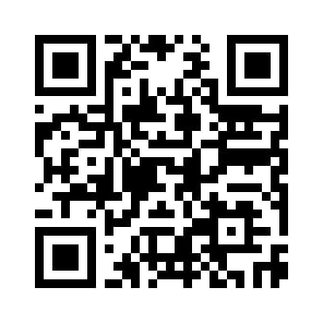
Thank you
https://linktr.ee/Danielle.Dias

